Slide 1
JCreator
CS 21a: Introduction to Computing I First Semester, 2016-2017

Slide 2
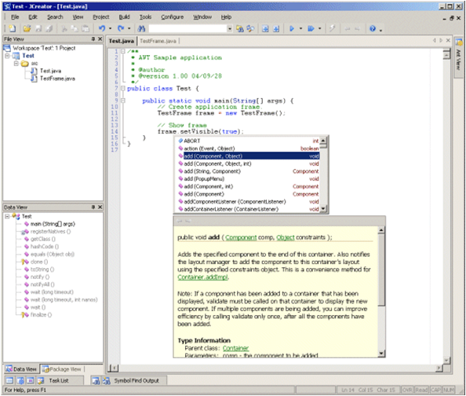
JCreator by Xinox Software

Slide 3
JCreator by Xinox Software
A small, lightweight IDE developed by Xinox Software
Two licenses available:
Lite edition: Freeware (limited features)
Pro edition: Shareware (requires payment, but with full features)
Download from http://www.jcreator.com

Slide 4
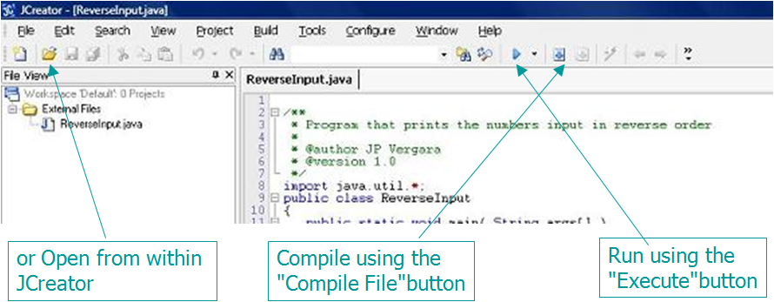
Compiling and Executing
Double-click on the Java source file to open the file using JCreator

Slide 5
JCreator Projects
Just like with BlueJ and other IDEs, there is an organized way to group Java files into projects
First, set the default project directory so that you know where your files will land
Configure → Options → Directories
Change the Default Project Directory to a folder you are familiar with

Slide 6
Creating a Project
File → New → Project
Indicate the name of the project (select Empty Project as the project type, for now)
Notice that a folder with the name you provided will be created under the default project directory specified in the previous slide
All files under the project will be placed inside this folder

Slide 7
Adding Files to a Project
After a project has been created (or selected)
File → New File to add a new file to the project
Project → Add Files… to add an existing file to the project
Try it!
Create a two-file project (a class and a tester project, for example)

Slide 8
Compiling and Executing a Project
To compile the entire project (all Java files within the project folder), click the Compile Project button, or
Build → Compile Project
Press the F7 key
To execute, click on the play or Execute button, or
Build → Execute Project
Press the F5 key
There are buttons to compile/execute individual files

Slide 9
Specifying the Run File
JCreator, automatically selects the Java program source with a main() method as the run file
This is what executes when the play button is clicked or F5 is pressed
If there are multiple files with a main() method
Project → Project Properties… then select the correct file under Run:

Slide 10
About JCreator Projects
Double-clicking on .jcp or .jcw files inside the project folder automatically opens the project within JCreator
.jcw specifies a workspace; there may be several projects in a workspace (but you will often have one-project workspaces)
There are other project types (e.g. Basic Applet) that automatically produce standard files/code
You may archive your project (e.g. when submitting) by zipping/compressing the project folder

